Slide 1
Measuring an Outcome of Interest

Slide 2
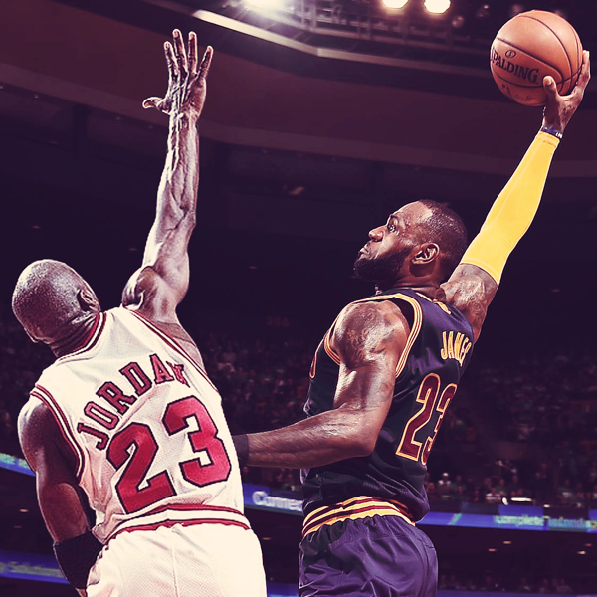
Lebron vs Jordan
Who is the GOAT?
aka-Greatest of all time
Notes:
Take poll and get student opinions on who they think is the better player and why. Then say “let’s see what the data says”
https://www.behance.net/gallery/53196937/LeBron-James-vs-Michael-Jordan

Slide 3
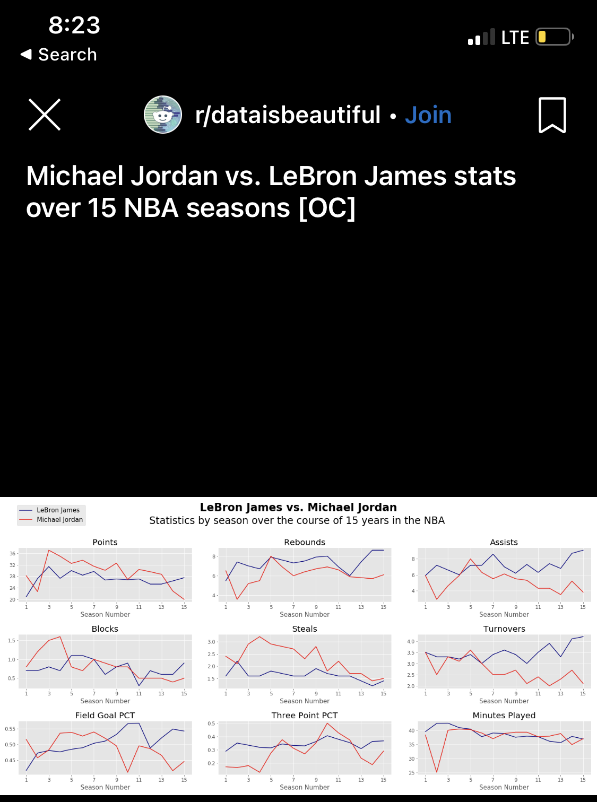
Lebron vs Jordan
Stats over 15 NBA seasons
Notes:
Lead/facilitate discussion this graph. Who is the best [according to this graph]? Michael Jordan.
Expect students to bring up other stats that are reflected here
Ask what makes player GOAT? What MORE data do we need to answer this question?

Slide 4

LeBron vs Jordan
Notes:
Ask what about according to this?
Lead/facilitate discussion this graph. Who is the best [according to this graph]? Michael Jordan.
Expect students to bring up other stats that are reflected here
Ask what makes player GOAT? What MORE data do we need to answer this question?

Slide 5
LeBron vs Jordan
Notes:
“What about when we consider all of this data?”
Allow students some time to process and then share their answers

Slide 6
ACT versus SAT
Which is the better score? SAT: 1050 or ACT: 23
How do we compare these two score?
The SAT is out of 1600
The ACT is out of 36
Notes:
Ask the students which test score is more impressive. Have them give their reasoning. They may calculate the percentage and (66% for SAT score and 64% for ACT score). But it's not that simple! The tests use different scales and scoring systems, so we need a better way to compare them. What might that be?In this case it is the percentile: the percent of data less than or equal to a certain data value. See next slide.

Slide 7
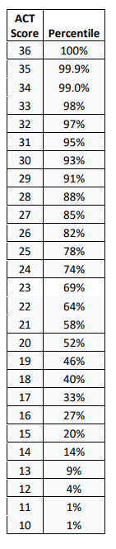
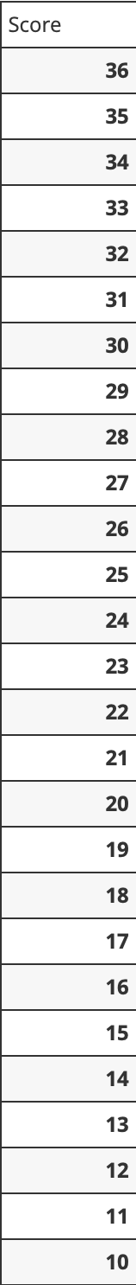
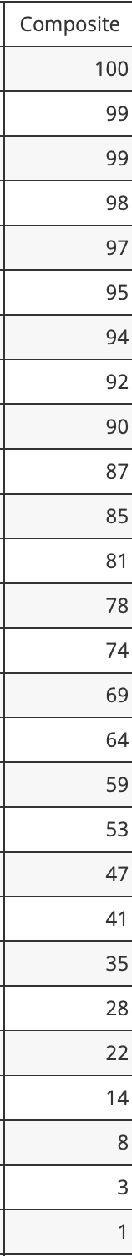
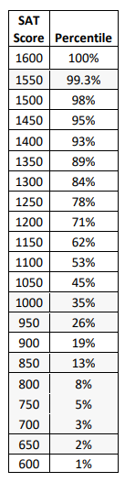
ACT versus SAT
SAT
ACT
Composite Score Range | Percentile Score
1530-1600 | 99 to 99+
1500-1530 | 98 to 99
1450-1500 | 96 to 98
1400-1450 | 93 to 96
1350-1400 | 90 to 93
1300-1360 | 86 to 90
1250-1300 | 81 to 86
1200-1250 | 75 to 81
1150-1200 | 68 to 75
1100-1150 | 61 to 68
1040-1100 | 51 to 61
990-1040 | 43 to 51
940-990 | 35 to 43
890-940 | 27 to 35
830-890 | 19 to 27
790-830 | 13 to 19
740-790 | 7 to 13
690-740 | 3 to 7
620-700 | 1 to 3
600-660 | 1- to 1
600 and below | 1-
Which is the better score? SAT: 1050 or ACT: 23
How do we compare these two score?
School Year:
2022 - 2023
Notes:
The tables display the percentiles of different scores on the SAT and ACT (based on 2019-2020 exam year) Using this information have students determine which score is better and give their reasoning.

